Slide 1

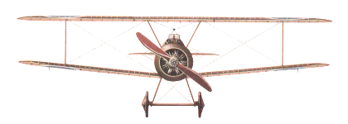
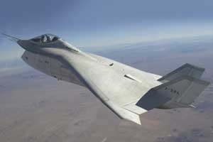
AS MAN EVOLVED ... SO DID THE TECHNOLOGIES THAT HE USED
1940s
2000s
Evolution of
Avionics
Architecture
& Data Buses
Dr. J. SHANMUGAM
MADRAS INSTITUTE OF TECHNOLOGY

Slide 2
AVIONICS
DEFINITION
Avionics : Aviation Electronics
Avionics : All electronic and electromechanical systems and subsystems (hardware and software) installed in an aircraft or attached to it. (MIL-1553A-HDBK)
Avionics has become an equal partner and is surpassing aircraft structures and propulsion in terms of cost and its mission effectiveness of modern aircraft

Slide 3
AVIONICS SYSTEM ARCHITECTURE
Establishing the basic architecture is the first and
the most fundamental challenge faced by the
designer
The architecture must conform to the overall aircraft
mission and design while ensuring that the avionics
system meets its performance requirements
These architectures rely on the data buses for intra
and intersystem communications
The optimum architecture can only be selected
after a series of exhaustive design tradeoffs that
address the evaluation factors

Slide 4
AVIONICS ARCHITECTURE
First Generation Architecture ( 1940’s –1950’s)
      Disjoint or Independent Architecture ( MiG-21)
      Centralized Architecture (F-111)
Second Generation Architecture ( 1960’s –1970’s)
      Federated Architecture (F-16 A/B)
      Distributed Architecture (DAIS)
      Hierarchical Architecture (F-16 C/D, EAP)
Third Generation Architecture ( 1980’s –1990’s)
      Pave Pillar Architecture ( F-22)
Fourth Generation Architecture (Post 2005)
      Pave Pace Architecture- JSF
      Open System Architecture

Slide 5
FGA - DISJOINT ARCHITECTURE
The early avionics systems were stand alone black boxes where each functional area had separate, dedicated sensors, processors and displays and the interconnect media is point to point wiring
The system was integrated by the air-crew who had to look at various dials and displays connected to disjoint sensors correlate the data provided by them, apply error corrections, orchestrate the functions of the sensors and perform mode and failure management in addition to flying the aircraft
This was feasible due to the simple nature of tasks to be performed and due to the availability of time

Slide 6
FGA - DISJOINT ARCHITECTURE
Pilot
Navigation Computer
Radar Processor
Navigation Panel
Inertial Measurement Unit
Altitude Sensor
Display…
Control Panel
RF ….

Slide 7
FGA - CENTRALIZED ARCHITECTURE
As the digital technology evolved,a central computer was added
to integrate the information from the sensors and subsystems
The central computing complex is connected to other
subsystems and sensors through analog,digital, synchro and
other interfaces
When interfacing with computer a variety of different transmission
methods , some of which required signal conversion (A/D) when
interfacing with computer
Signal conditioning and computation take place in one or more
computers in a LRU located in an avionics bay , with signals
transmitted over one way data bus
Data are transmitted from the systems to the central computer
and the DATA CONVERSION TAKES PLACE AT THE CENTRAL
COMPUTER

Slide 8
FGA - CENTRALIZED ARCHITECTURE
ADVANTAGES
Simple Design
Software can be written easily
Computers are located in readily accessible bay
DISADVANTAGES
Requirement of long data buses
Low flexibility in software
Increased vulnerability to change
Different conversion techniques needed at Central
Computer
Motivated to develop a COMMON STANDARD INTERFACE for interfacing the different avionics systems.

Slide 9
FGA - CENTRALIZED ARCHITECTURE
Tape
GNC
WDC
HSI
Multiplexer Converter
HSD
FCS
Attack Radar
Terrain Following Radar
Inertial Navigator Set
SMS
Nav Data Display Panel
RADALT
Nav Data Entry Panel
TACAN
Doppler Radar
Integrated Display Set
Maintenance Control Unit

Slide 10
SGA – FEDERATED ARCHITECTURE
Federated : Join together, Become partners
Each system acts independently but united
(Loosely Coupled)
Unlike FGA – CA , Data conversion occurs at the system level and
the datas are send as digital form – called Digital Avionics
Information Systems(DAIS)
Several standard data processors are often used to perform a
variety of Low – Bandwidth functions such as navigation, weapon
delivery , stores management and flight control
Systems are connected in a Time – Shared Multiplex Highway
Resource sharing occurs at the last link in the information chain –
via controls and displays
Programmability and versatility of the data processors

Slide 11
SGA – FEDERATED ARCHITECTURE
ADVANTAGES
  Contrast to analog avionics – DDP provide precise solutions
  over long range of flight , weapon and sensor conditions
  Sharing of Resources
  Use of TDMA saves hundreds of pounds of wiring
  Standardization of protocol makes the interchangeability of
  equipments easier
  Allows Independent system design and optimization of
  major systems
  Changes in system software and hardware are easy to make
  Fault containment – Failure is not propagated
DISADVANTAGES : Profligate of resources

Slide 12
SGA - DAIS HARDWARE ARCHITECTURE
Processor1
Processor2
Processor M
Bus Control Interface
Bus Control Interface
……
Data bus A
Bus Control Interface
Data bus B
……
Remote Terminal 1
Remote Terminal 2
Remote Terminal N
Sensor Equipment
Sensor Equipment
Control & Display Equipment

Slide 13
SGA - DISTRIBUTED ARCHITECTURE
It has multiple processors throughout the aircraft that are designed
for computing takes on a real-time basis as a function of mission
phase and/or system status
Processing is performed in the sensors and actuators
ADVANTAGES
Fewer,Shorter buses
Faster program execution
Intrinsic Partitioning
DISADVANTAGES
Potentially greater diversity in processor types
which aggravates software generation
and validation

Slide 14
SGA – HIERARCHICAL ARCHITECTURE
This architecture is derived from the federated architecture
It is based on the TREE Topology
ADVANTAGES
Critical functions are placed in a separate bus and Non-Critical
functions are placed in another bus
Failure in non – critical parts of networks do not generate
hazards to the critical parts of network
The communication between the subsystems of a particular
group are confined to their particular group
The overload of data in the main bus is reduced
  Most of the military avionics flying today based on
HIERARCHICAL ARCHITECTURE

Slide 15
SGA - HIERARCHICAL SYSTEM
EAP AVIONICS SYSTEM

Slide 16
TGA - WHY PAVE PILLAR
Pave Pillar is a USAF program to define the requirements and avionics architecture for fighter aircraft of the 1990s
The Program Emphasizes
  Increased Information Fusion
  Higher levels and complexity of software
  Standardization for maintenance simplification
  Lower costs
  Backward and growth capability while making use of
  emerging technology – VHSIC, Voice Recognition /synthesis
  and Artificial Intelligence
Contd…

Slide 17
TGA - WHY PAVE PILLAR
Provides capability for rapid flow of data in, through and from
the system as well as between and within the system
Higher levels of avionics integration and resource sharing of
sensor and computational capabilities
Pilot plays the role of a WEAPON SYSTEM MANAGER as
opposed to subsystem operator/information integrator
Able to sustain operations with minimal support, fly successful
mission day and night in any type of weather
Face a numerically and technologically advanced enemy
aircraft and defensive systems

Slide 18
TGA - PAVE PILLAR
Higher
Sustainability
PP
Lower
LCC
Mission
Effectiveness

Slide 19
TGA – PAVE PILLAR ARCHITECTURE
    Component reliability gains
    Use of redundancy and resource sharing
    Application of fault tolerance
    Reduction of maintenance test and repair time
    Increasing crew station automation
    Enhancing stealth operation
    Wide use of common modules (HW & SW))
    Ability to perform in-aircraft test and maintenance of avionics
    Use of VHSIC technology and
    Capability to operate over extended periods of time at austere,
    deployed locations and be maintainable without the Avionics
    Intermediate Shop

Slide 20
FTGA - WHY PAVE PACE
Modularity concepts cuts down the cost of the avionics related to
VMS, Mission Processing, PVI and SMS
The sensor costs accounts for 70% of the avionics cost
USAF initiated a study project to cut down the cost of sensors
used in the fighter aircraft
In 1990, Wright Laboratory – McDonnell Aircraft, Boeing aircraft
company and Lockheed launched the Pave Pace Program
Come with the Concept of Integrated Sensor System(IS²)
Pave Pace takes Pave Pillar as a base line standard
The integration concept extends to the skin of the aircraft –
Integration of the RF & EO sensors
Originally designed for Joint Strike Fighter (JSF)

Slide 21
FTGA – PAVE PACE

Slide 22
AVIONICS SYSTEM EVOLUTION

Slide 23
KEY OBSERVATIONS
AVIONICS ARCHITECTURAL EVOLUTION
Increased Digitization of Functions
Increased sharing and modularization of functions
Integration/ sharing concepts increased to the skin of the
aircraft
Functionality has increasingly obtained through software
Complex hardware architecture modules
Complex software modules
Increased network complexity and speed

Slide 24

Data Bus
It provides a medium for the exchange of
data and information between various
Avionics subsystems
Integration of Avionics subsystems in
military or civil aircraft and spacecraft.

Slide 25
Protocol
set of formal rules and conventions governing the flow of information among the systems
Low level protocols define the electrical and physical standards
High level protocols deal with the data formatting, including the syntax of messages and its format

Slide 26
TYPES OF PROTOCOLS
Command/Response :Centralized Control Method
Token Passing : Decentralized Control Method
(Free token)
CSMA/CA : Random Access Method

Slide 27
Topology
How the systems are interconnected in a particular fashion
LINEAR NETWORK
Linear Cable
All the systems are connected in across the Cable
RING NETWORK
Point to Point interconnection
Datas flow through the next system from previous system
SWITCHED NETWORK
Similar to telephone network
Provides communications paths between terminals

Slide 28
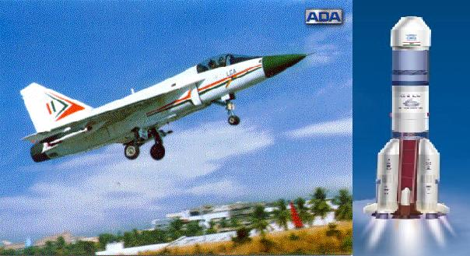
MIL-STD 1553B

Slide 29
History of the MIL-STD-1553B
Developed at Wright Patterson Air Force
Base in 1970s
Published First Version 1553A in 1975
Introduced in service on F-15 Programme
Published Second version 1553B in 1978

Slide 30
MILITARY STANDARD 1553
MIL-STD-1553, Command / Response Aircraft Internal Time Division Multiplex Data Bus, is a Military standard (presently in revision B), which has become one of the basic tools being used today for integration of Avionics subsystems
This standard describes the method of communication and the electrical interface requirements for the subsystems connected in the data bus

Slide 31
SPECIFICATION OVERVIEW
Data Rate
1 Mbps
Word Length
20 Bits
Message Length
32 Word Strings(maximum)
Data Bits per Word
16 Bits
Transmission Technique
Half - Duplex
Encoding
Manchester II Bi-phase
Protocol
Command Response
Transmission Mode
Voltage Mode

Slide 32
ELEMENTS OF MIL-STD-1553B
BUS CONTROLLER (BC)
REMOTE TERMINAL (RT)
MONITORING TERMINAL (MT)
TRANSMISSION MEDIA

Slide 33
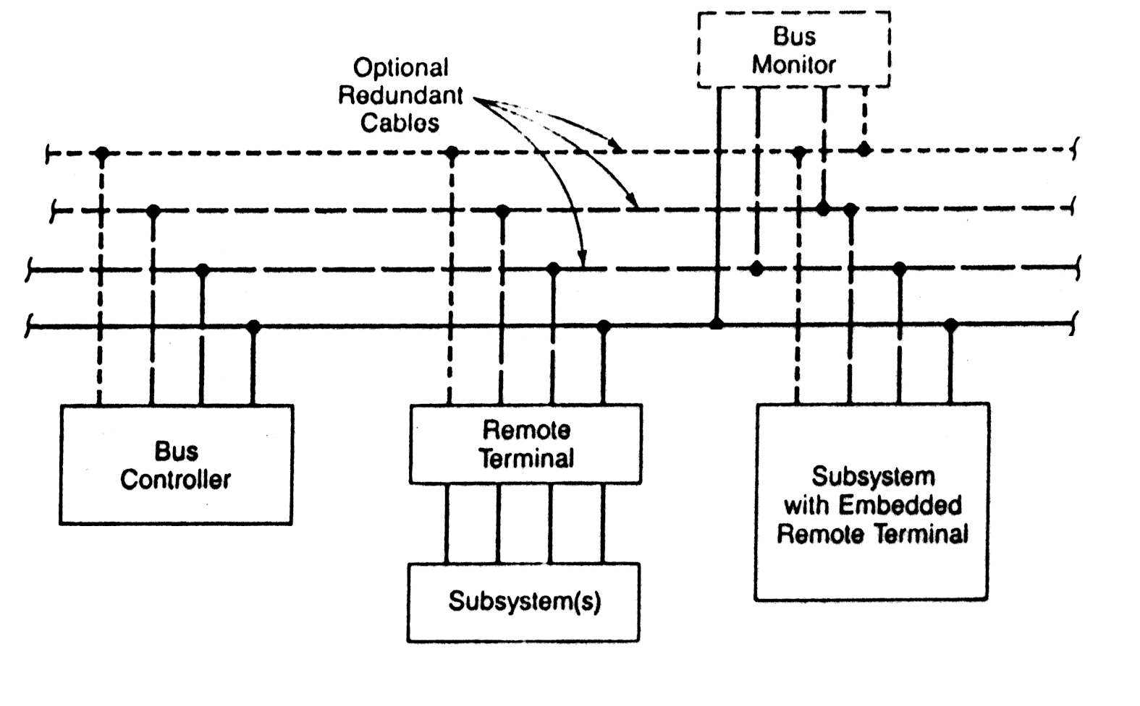
BUS ARCHITECTURE

Slide 34
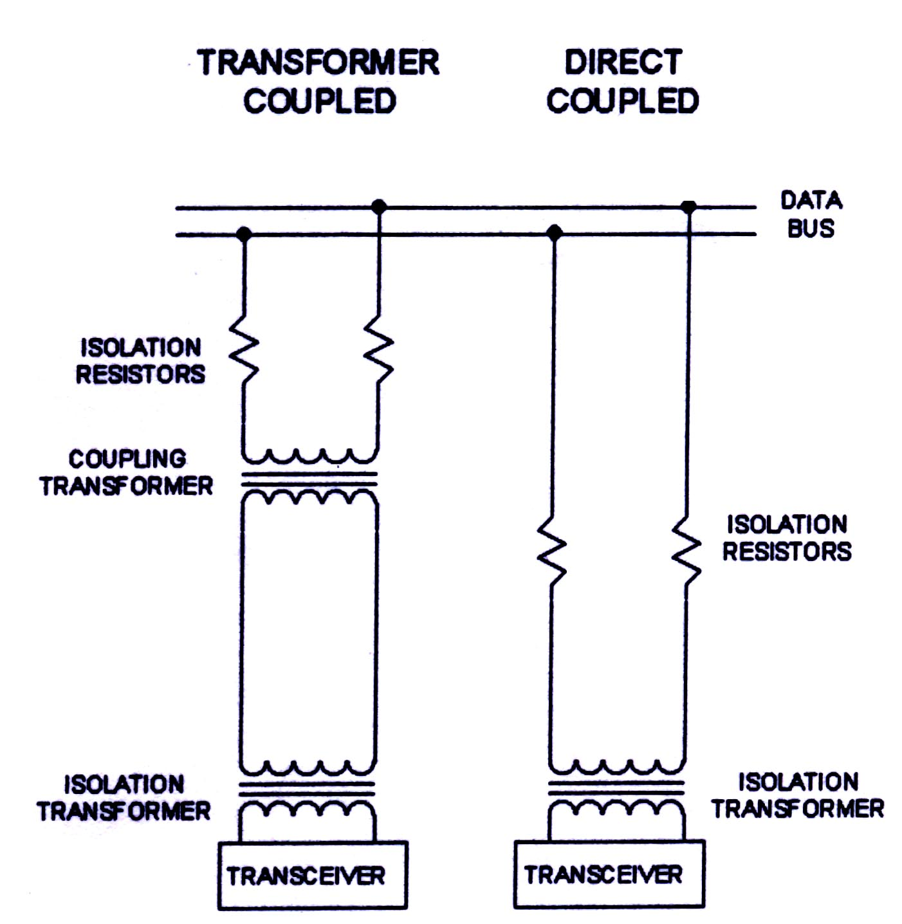

COUPLING METHODS

Slide 35
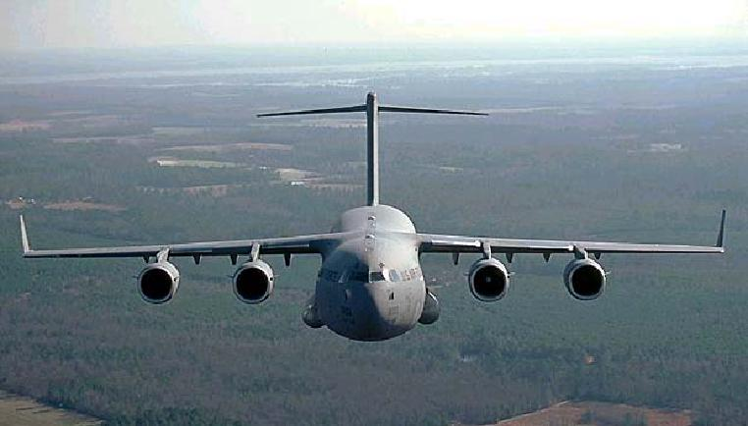
ARINC 429

Slide 36
HISTORY & MOTIVATION
Single point failure in 1553B leads to certificability problem in civil aircraft
Addition of remote terminal requires changes in BC software which requires frequent certification
Standard adopted in the year 1977
Made its appearance in the C-17 transport aircraft
Point to Point Protocol

Slide 37
ARINC SPECIFICATION 429
It is a specification that defines a local area network for transfer of digital data between avionics system elements in civil aircraft.
It is simplex data bus using one transmitter but no more than twenty receivers for each bus implementation
There are no physical addressing. But the data are sent with proper identifier or label
Contd…

Slide 38
ARINC 429 is viewed as a permanent as a broadcast or multicast operation
Two alternative data rates of 100kbps and 12-14 Kbps
There is no bus control in the data buses as found in MIL-STD 1553B
It has direct coupling of transmitter and receiving terminals

Slide 39
ARINC 429 ARCHITECTURE
UPTO 20 RECEIVERS
TOTAL
ARINC 429 DATABUS
ARINC 429
TRANSMITTER
ARINC 429
RECEIVER
ARINC 429
RECEIVER
ARINC 429
RECEIVER

Slide 40
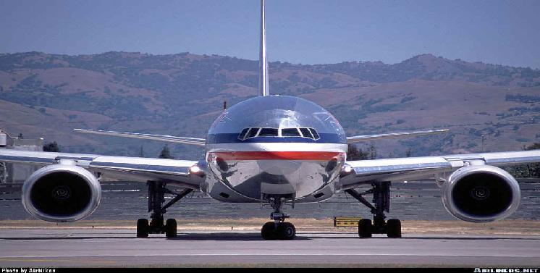
ARINC 629

Slide 41
BIRTH OF ARINC 629
1977 => Boeing began to work on “DATAC” project
1977 - 85 => DATAC Emerged as ARINC 629
1989 => ARINC 629 was adopted by AEEC
1990 => ARINC 629 was first implemented in BOEING-777

Slide 42
ARINC 629 DATA BUS
Time Division Multiplex
Linear Bus
Multiple Transmitter Access
2 Mbps Data Rate
Current Mode Coupling
(Present implementation)

Slide 43
SPECIFICATION OVERVIEW
Data Rate
2 Mbps
Word Length
20 Bits
Message Length
31 Word Strings(maximum)
Data Bits per Word
16 Bits
Transmission Technique
Half - Duplex
Encoding
Manchester II Bi-phase
Protocol
Carrier Sense Multiple Access
Collision avoidance
Transmission Mode
Voltage Mode,Current Mode, Fiber Optic Mode

Slide 44
ARNIC 629 ARCHITECTURE
UPTO 120 SUBSCRIBER
TERMINALS
ARINC 629 DATABUS
ARINC 629
TERMINAL
ARINC 629
TERMINAL
ARINC 629
TERMINAL

Slide 45
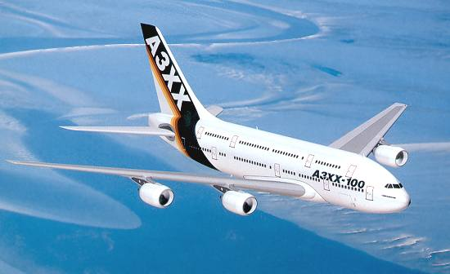
AFDX

Slide 46
Avionics Fully Duplex Switched Ethernet is an advanced Protocol Standard to interconnect avionics subsystems
It can accommodate future system
bandwidth demands
Increase flexibility in Avionics design
Reduce aircraft wire counts, thus
lowering aircraft weight and cost
Its first major use in A3xx

Slide 47
Since the Ethernet is a switched architecture rather than a point-point link, aircraft designers can create redundant sub networks
Faults can be isolated and analysed without impacting the system as a whole
ARINC 429 data bus may still be used but the main Avionics data pipe will be Ethernet (AFDX) of 100 Mbps

Slide 48
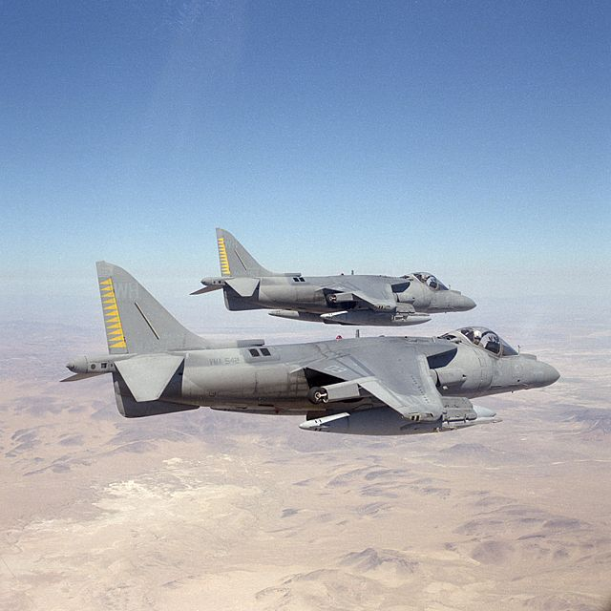
HSDB

Slide 49
Used in F-22 Advanced tactical fighter
Generic version SAE Aerospace Standard 4074.1
50 Mbps- linear bus
for optical medium implementation – star topology
HSDB uses distributed control in which each terminal is permitted to transmit only when it receives the token frame.

Slide 50
SCI

Slide 51
IEEE –STD-1596-1992
SCI is an interconnect system for both backplane and LAN usage.
It is a system of rings and switches in its basic format
Operates at 1 Gbps
Electrical links upto 30m and optical links upto several kms.
Same Bandwidth as today’s 155Mbits/sec ATM links , 32 times that of today’s fiber optic channel and 800 times that of Ethernet.

Slide 52
DATABUS
COMPARISION

Slide 53
1553B ARINC629 ARINC 429 ETHERNET
Standard Def-Stan ARINC ARINC IEEE 802.3
STANAG ISO 8802.3
3838
Status Published Published Published Published
Primary USAF Boeing Civil INTEL Support US DOD Airlines

Slide 54
PERFORMANCE
Signaling Rate
1553B - 1Mbps
Ethernet(AFDX) - 100Mbps
ARINC 429 - 100Kbps or 12- 14.5Kbps
ARINC 629 - 2Mbps

Slide 55
BUS ACCESS
1553B - Predetermined
Ethernet - Not Determined
ARINC 429 - Fixed
ARINC 629 - Multitransmitter

Slide 56
Coupling
1553B - Transformer
Ethernet - Transformer
ARINC 429 - Direct
ARINC 629 - Transformer

Slide 57
Protocol Features
Access Method
1553B - Time Division
Ethernet - CSMA/CD
ARINC 429 - Fixed (Single Transmitter)
ARINC 629 - CSMA/CA

Slide 58
Hierarchy
1553B - Master/Slave
Ethernet - No Master
ARINC 429 - No Master
ARINC 629 - No Master

Slide 59
NUMBER OF NODES
1553B - 31(RT) + BM + BC
Ethernet - 100 +
ARINC 429 - 20
ARINC 629 - 120

Slide 60
MIL-STD 1773

Slide 61
WHY OPTICAL FIBER?
Though 1553B is used in various modern aircraft, it is recognised that buses operate in extremly severe environment like
EMI from intersystem and intrasystem
Lightning
Electrostatic discharge
High Altitude Electromagnetic pulse

Slide 62
About 1773
Fiber-optic version of 1553B
It also operates at the rate of 1Mbps
It also have the same 20 bit word and three words such as command word, status word and data word
stronger immunity to radiation-induced electromagnetic interference

Slide 63
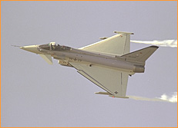
STANAG 3910

Slide 64
HISTORY OF STANAG 3910
Motivation of the STANAG 3910
Draft Created in Germany during 1987
Draft Submission on 1988
A Project EFA Bus was issued on 1989
Selected by the Euro fighter consortium
in 1989

Slide 65
STANAG 3910
To meet the Demands of Avionics requirements
for Highly Sophisticated fighter aircraft
Allow Evolution from MIL-STD-1553B Bus to
“Higher Speed” Avionics Bus System
Stay with a Deterministic Master/Slave Protocol
“Low Risk” approach to EF2000 Prototypes using
MIL-STD-1553B only

Slide 66
SPECIFICATION OVERVIEW
Data Rate
1 Mbps (LS), 20Mbps (HS)
Word Length
16 Bits
Message Length
32 Word(LS), 4096 Word (HS)
Max No. of Stations
32
Transmission Technique
Half - Duplex
Access Protocol
Command /Response

Slide 67
COMPARISON BETWEEN
MIL-STD-1773 and STANG 3910
MIL-STD-1773 is same as the 1553B with
Fiber-Optic Media
STANAG 3910 operates under the control of
STANAG 3838 (1553)
The data rate in 1773 is 1Mbps
The STANAG 3910 has 2 data rates
  1 Mbps in 3838
  20 Mbps in Optical bus

Slide 68
CAN BUS

Slide 69
Controller Area Network (CAN) is the network
Established among microcontrollers.
CSMA/CA Protocol
Two wire high speed network system which was
firstly Established to overcome the problems
(wire harness,Communication) faced in
automobiles.
Linked up to 2032 devices(assuming one node
with one identifier) on a single network.
CAN offers high speed communication up to
1Mbps, thus allowing real time control.

Slide 70
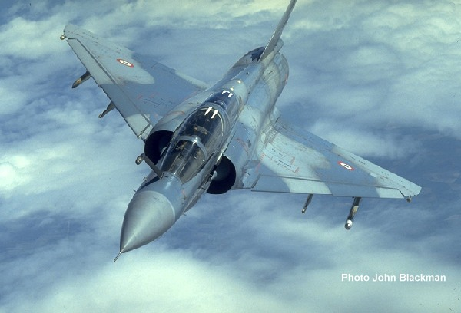
DIGIBUS

Slide 71
Digibus
Originally Ginabus (Gestion des Informations Numeriques Aeroportees – Airborne Digital Data Management)
Designed jointly by Electronique Serge Dassault (ESD) and Avions Marcel Dassault- Breguet Aviation (AMD-BA) and SAGEM between 1973 and 76
Digibus is now standard for all branches of French Military is defined in the Specification GAM-T-101

Slide 72
SPECIFICATIONS
Digibus operates at 1 Mbits /sec.
Uses two twisted cable pairs shielded with two mesh screens, one cable pair conveys data and the other carries protocol messages.
The protocol messages are similar to MIL-STD-1553.
Maximum bus length is 100meters. But active repeaters allow extension up to 300 meters plus sub-bus couplers that can be used to connect sub buses (each up to 100 meters long) on to the main bus.

Slide 73

DATA BUSES
IN
SPACE APPLICATIONS

Slide 74
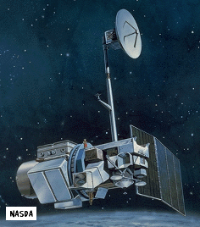
IEEE 1393
SPACEBORNE
FIBER OPTIC
DATA BUS

Slide 75
ON Board Data Handling networks
High Speed payloads
SFODB is 1 Gbps, support real time and
On Board Data handling requirement of
Remote Sensing satellites
Highly reliable, fault tolerant, and capable of withstanding the rigors of launch and the harsh space environment.

Slide 76
Small size, light weight, and low power
Architecture Redundant, Cross-Strapped Fiber Optic Ring with Passive Bypass
Standard Protocol IEEE 1393-1999
Node Capacity 127 Transmit & Receive Nodes

Slide 77
In Space shuttles
Two commonly used data buses
1. Multiplex interface adapter(MIA)
2. Multiplex/demultiplexer data bus (MDM)

Slide 78
MIA Data Bus
  Command/response protocol
  24 bit words(plus sync&parity)
  Same as to 1553 data bus in speed and
  biphase Manchester encoding
  Words are 24 bits long while in 1553 20 bits long

Slide 79

MDM DATA BUS
Serial point to point communication
Between space shuttle payload general support computer and various subsystems
MDM interface consists of a serial data bus and three discretes (Message in, Message out and word)
Discrete contains the timing , direction and No. of words on the serial data bus

Slide 80
Serial data bus is bi-directional
Discrete are driven by bus controller
(the PGSC) and received by the remote Terminal
Speed is 1 Mbps
Words have 16 bits, messages upto 32 words

Slide 81
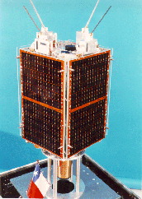
CAN BUS

Slide 82
CAN BUS
In Space Applications
FASat-ALPHA(Chile) will carry an advanced OBDH system
In this, Controller Area Network (CAN) bus is used to connect all processing nodes

Slide 83
ROMER-a DANISH satellite, ACS will be implemented on an on-board connected to a CANBUS in order to communicate with sensors and actuators of the ACS.
CANBUS network is used for connecting all components via an interface,within the body in TG-A launch vehicles.

Slide 84
MIL-Std 1553 Data Bus in
Space Applications

Slide 85
TAOS-Technology for Autonomous
Operational survivability
In TAOS Satellite 1553 is used for
intersatellite communications
Two MIL-Std 1750A(Processor) are
used for spacecraft control and
payload operation

Slide 86
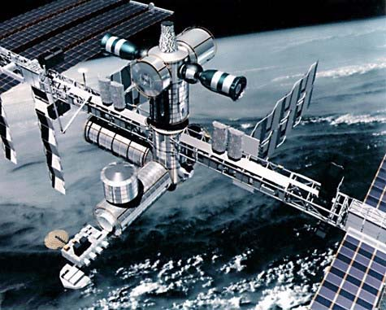
SPACE STATION

Slide 87
International Space Station
MIL-Std 1553 Data Buses are used
for a common data link between all
segments of U.S. laboratory Module,
Russian Service Module and functional
Cargo block, the European Columbus
Orbital facility and the Japanese
Experimental Modulej

Slide 88
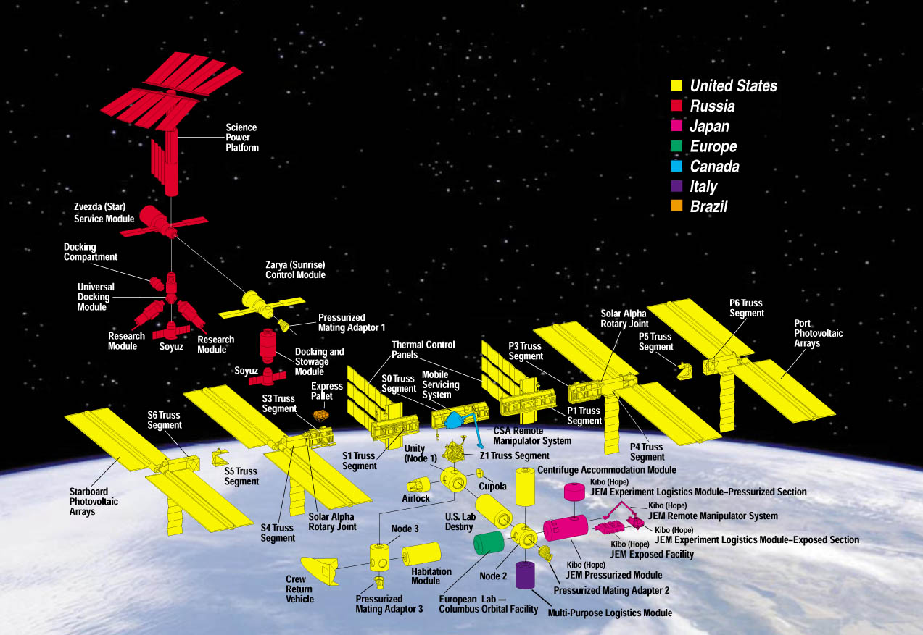

Slide 89
In SWAS , NASA’s UBMILLIMETER WAVE ASTRONOMY SATELLITE use 1553 data bus for On-Board Data Handling system
In TRACE, NASA TRANSITION REGION AND CORNAL EXPLORER employ 1553 to connect subsystems.

Slide 90
Microstar Satellite platform uses 1553 Or 1773 Buses for payload data interface To accommodate high level interfaces.
NASA’s Goddard Space Flight Center use a common bus for several satellites Which is attained by 1553 and 1773 buses
Globstar system consider 1553 as a
common reference design

Slide 91
THANK YOU

